Slide 1


Slide 2




GROUP-7 TEAM MEMBERS
Bhavya Deepthi
Venkat Prudhvi
Hareesh Bhuma
Raghunandan

Slide 3
Agenda
Introduction
How Alexa Skills Work
Create a Skill on the Amazon Developer Portal
Create a Language Model
AWS Lambda
Applications
Demo
Conclusion

Slide 4
Introduction
Alexa is the voice service that powers Echo device, or skills, that enable customers to interact with devices in a more intuitive way using voice.
Examples of these skills include the ability to play music, provide information, deliver news and sports scores, tell you the weather information.
Alexa is built in the cloud, so it is always getting smarter.

Slide 5
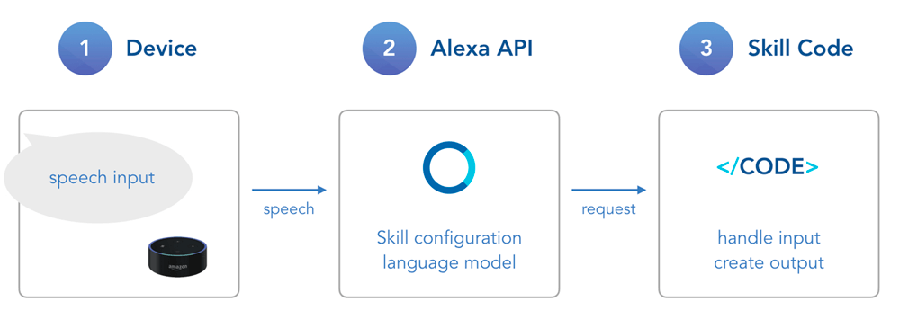
How Alexa Skills Works?

Slide 6
Cont…
A user talking to an Alexa enabled device (speech input), which is passed to...
the Alexa API which understands what the user wants (through natural language understanding), and creates a request, which is passed to...
your Skill code which knows what to do with the request.

Slide 7
Create a Skill on the Amazon Developer Portal
The Amazon Developer Portal is the console where you can add your Skill as a project, configure the language model, test if it's working, and publish it to the Alexa Skill Store.
Now it's time to create a new project on the developer console. Click on the "Alexa" menu item in the navigation bar and choose "Alexa Skill Kit" to access your Alexa Skills

Slide 8
Create a Language Model
Interaction Model consists of an Invocation, Intents, and Slot Types.
Alexa helps you with several steps in processing input. First, it takes a user's speech and transforms it into written text (speech to text). Afterward, it uses a language model to make sense out of what the user means (natural language understanding).

Slide 9
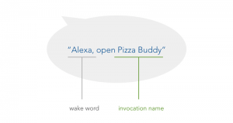
Invocation
There are two types of names for your Alexa Skill: While the first, the Name is the one people can see in their Alexa app and the Alexa Skill Store, the Invocation Name is the one that is used by your users to access your Skill

Slide 10
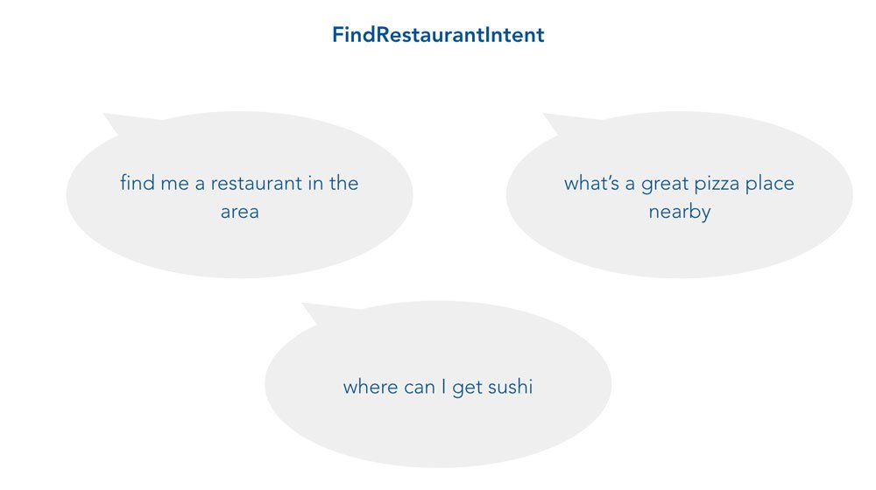
Intent
An intent is something a user wants to achieve while talking to your product. It is the basic meaning that can be stripped away from the sentence or phrase the user is telling you. And there can be several ways to end up at that specific intent.

Slide 11
Cont…
You define interactions for your skill through Intents.
Intents are defined in JSON structure.

Slide 12
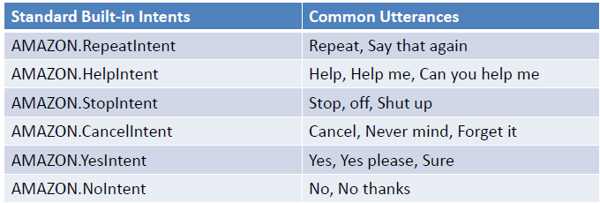
Standard Built-in Intents
Standard Intents used for common actions
These intents do not use slots

Slide 13
Utterances
An utterance (sometimes called user expression) is the actual sentence a user is saying. There are often a large variety of utterances that fit into the same intent. And sometimes it can even be a little more variable. This is when slots come into play:

Slide 14
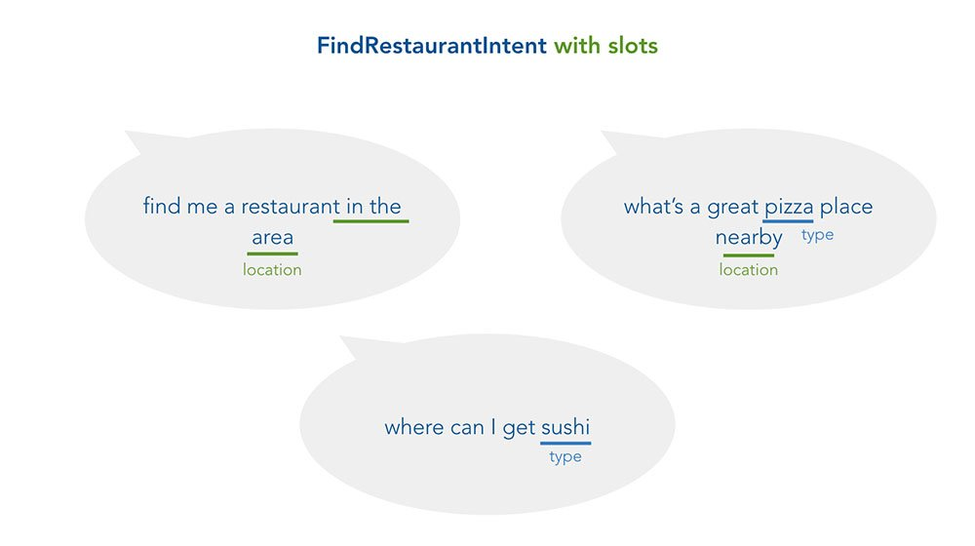
Slots
No matter if I'm looking for a super cheap place, a pizza spot that serves Pabst Blue Ribbon, or a dinner restaurant to bring a date, generally speaking it serves one purpose (user intent): to find a restaurant. However, the user is passing some more specific information that can be used for a better user experience. These are called slots:

Slide 15
Slot Types
Standard Slot Types:
• Alexa Skills Kit defines several slot types.
• Numbers, Dates & Times
• List of Items
Custom Slot Types:
• Defines a list of possible values.
• Text File

Slide 16
Standard Slot Types

Slide 17
AWS Lambda
The easiest way to build the cloud-based service for a custom Alexa skill is to use AWS Lambda an Amazon Web Services offering that runs your code only when it's needed and scales automatically, so there is no need to provision or continuously run servers.
You upload the code for your Alexa skill to a Lambda function and Lambda does the rest, executing it in response to Alexa voice interactions and automatically managing the compute resources for you.

Slide 18
Using AWS Lambda..
You do not need to administer or manage any of the compute resources for your service.
You do not need an SSL certificate.
AWS Lambda runs your code only when you need it and scales with your usage, so there is no need to provision or continuously run servers.
AWS Lambda supports code written in several languages, including Node.js, Java, and Python.

Slide 19
Connect the Lambda function to your skill
To connect the function with your skill, you need to update the Endpoint field for your skill to the AWS Lambda ARN for your function.
Copy the ARN shown in the upper-right corner of your Lambda function.
Open or create your skill in the developer console.

Slide 20
Cont..
Amazon Developer portal generates input file for lambda in JSON format.
The JSON file is automatically converted into JS format before it reaches the lambda.
After the function runs, the Execution result section shows the response returned by the function, in JSON format in Amazon developer portal.

Slide 21
Amazon Alexa Commands
Alexa, what is the weather in Maryville
Alexa, Who is Steve jobs?
Alexa, set time for 15 minutes
Alexa, set the bedroom to 20 degrees

Slide 22
Applications

Slide 23
Competitors

Slide 24
Project’s Functionality

Slide 25
Login to Amazon developer and AWS Lambda Console
Invocation and slot input
Heroku Server
Lambda Code
Updating Content JSON file
Heroku Server
Content update in Index.html
Reference from JSON file
Main.js
Updating the data retrieved from API

Slide 26
Conclusion
Amazon Echo is a big step forward when it comes to voice control technology. It’s always on microphones and integration with third-party apps means that there really are a ton of things that you can do using just your voice.
As the technology continues to improve, so will the number of things you can do with Alexa.

Slide 27
References
https://www.jovo.tech/tutorials/alexa-skill-tutorial-nodejs
https://www.creativebloq.com/how-to/create-an-alexa-skill-for-your-site
https://www.youtube.com/watch?v=BB3wwxgqPOU
Server hosted in heroku using Anil Bomma’s JSON file.

Slide 28


